Slide 1


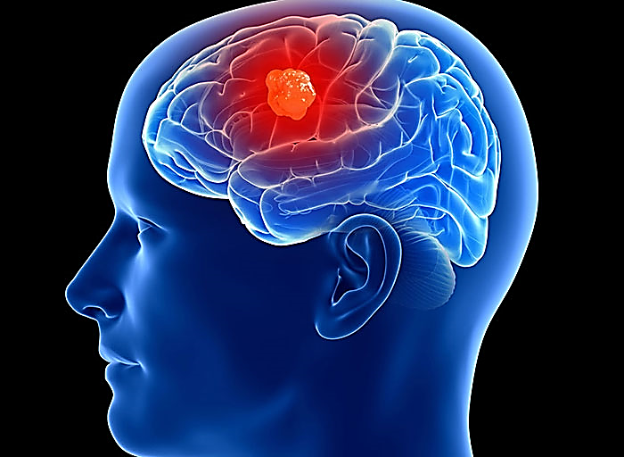
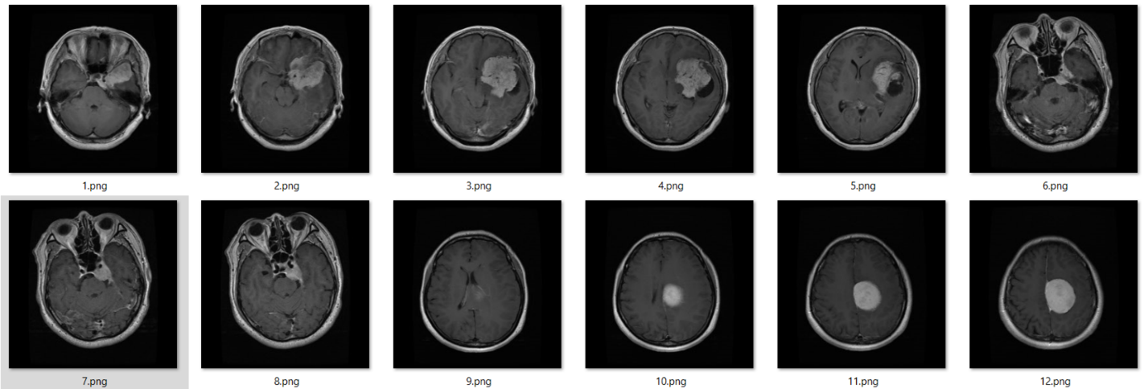
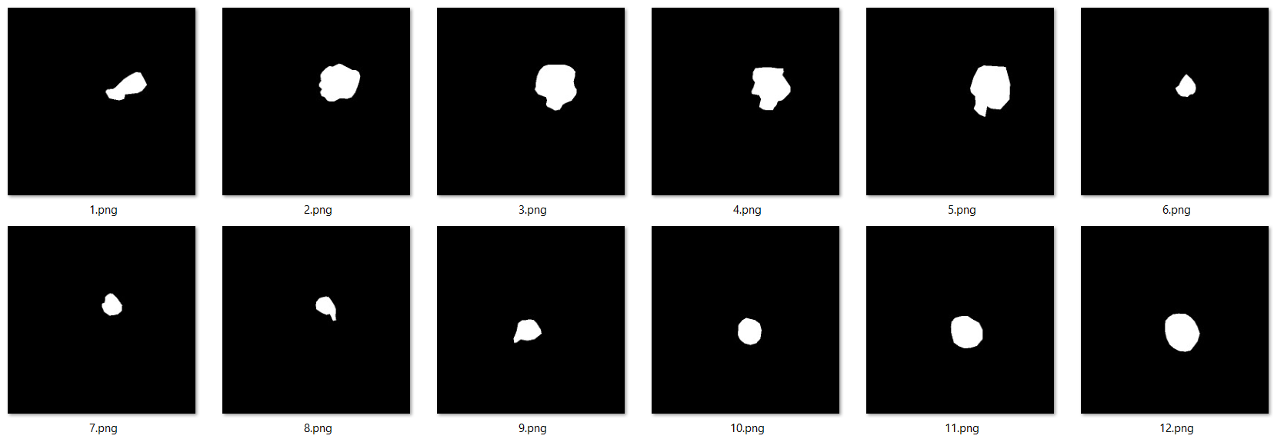
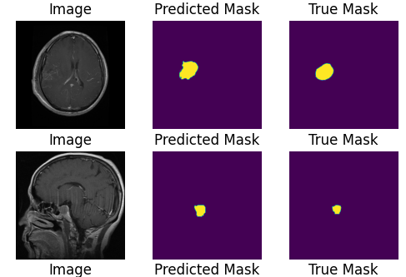
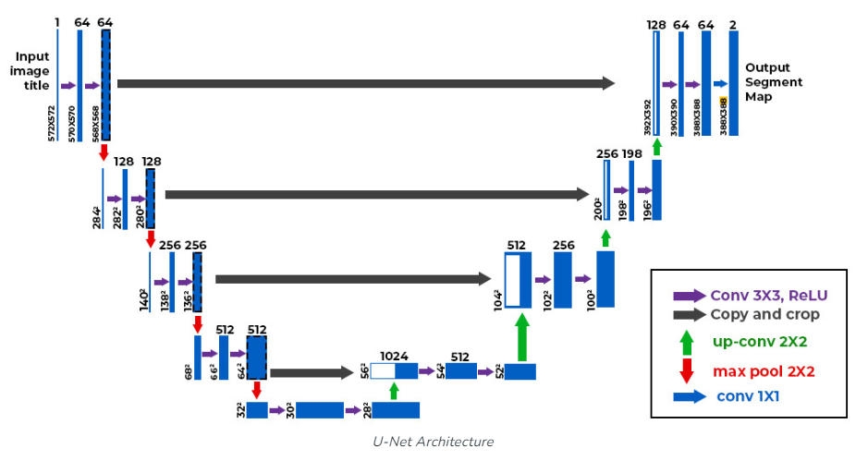
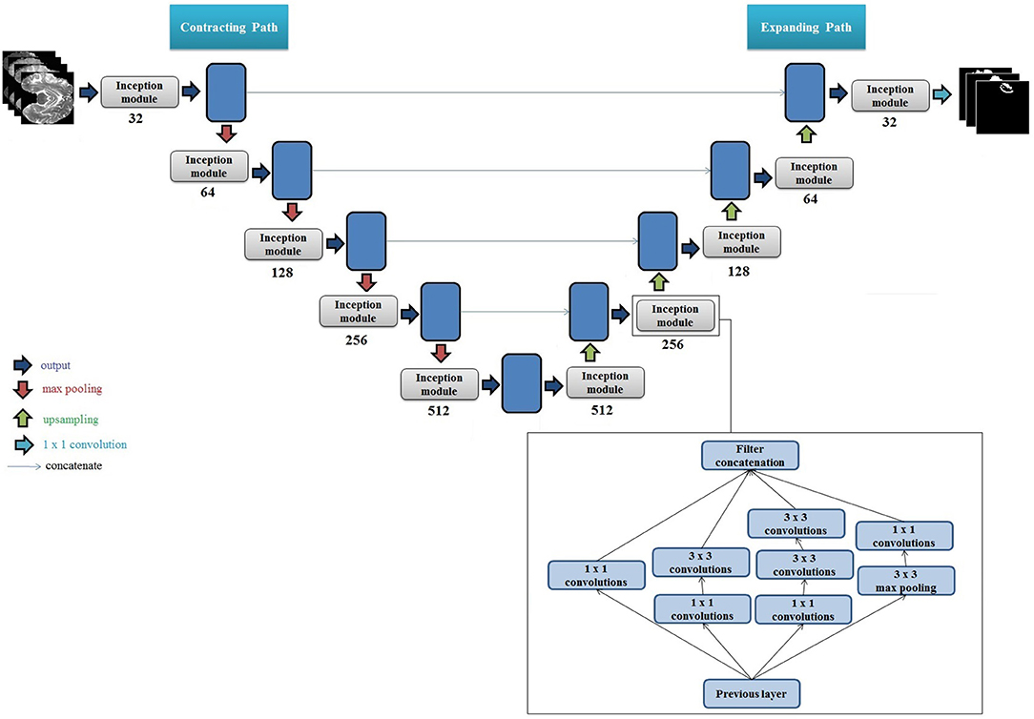
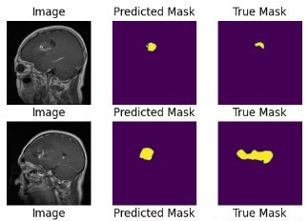
Team 2
Segmentation of Brain Tumor MRI Images Using Deep Learning
Abstraction
The human brain is susceptible to tumor development when cell division goes awry, forming abnormal clusters within or around the brain. These tumors, generically termed brain tumors, arise from uncontrolled cellular growth and can vary in severity.
Dataset Description
Methodological Steps
The dataset utilized comprises two distinct folders (images and masks), each containing 3064 PNG images. The images are grayscale and possess dimensions of 512x512 pixels, portraying MRI scans of the brain.
Data Preprocessing
Model
Implementation
and
Compilation
Training Procedure
Model
Evaluation
Model Evaluation
Figure 1 Brain tumor
Introduction
Figure 2 MRI Images
98.29%
98.19%
98.19%
Brain tumor segmentation plays a critical role in medical imaging for accurate diagnosis and treatment planning .The objective of this project is to perform brain tumor segmentation on MRI images using different deep learning architectures. like :
U-Net
Inception U-Net
VGG
Loss:
Dice Coefficient:
Loss:
Dice Coefficient:
Loss:
Dice Coefficient:
U-NET Inception
Figure 3 Masks
U-NET
VGG
Methodology
VGG
Sample Of Predicted and Actual Masks
U-NET
Literature Review
U-NET Inception
Inception Modules Enhance Brain Tumor Segmentation:
U-Net with Intra-Tumoral Structures.
U-Net with Glioma Sub-Regions
U-Net with Inception Modules and Intra-Tumoral Structures Objective
U-Net with Inception Modules and Glioma Sub-Regions Objective
Figure 4 U-Net
Figure 6 Sample Of Predicted and Actual Masks For Inception U-Net
Rigorous evaluation demonstrated significant improvements in tumor segmentation performance when integrating Inception modules into the U-Net architecture.
Advanced Level Foundation
Extended Foundation
Advanced Level Foundation
MRI Brain Tumor Segmentation Using U-Net:
IELTS 5.0
The main objective was to develop an automated system to segment brain tumor images with minimal error using the U-Net algorithm. Apply U-Net for image segmentation to precisely identify and localize tumors.
Advanced Level Foundation
Figure 5 Inception U-Net
Figure 7 Sample Of Predicted and Actual Masks For U-Net
Sondos Mahmoud Manar Ashraf Noura Osama lamees Lama Zkaria

